Slide 1
will sheffler gm1604

Slide 2
outline
very brief overview
a few tests/benchmarks
new RIF docking methods
fast packing of RIF rotamers
simple constraints

Slide 3


RIF Docking
BB xyz frame
BB xyz frame
BB xyz frame
BB xyz frame
kinda like docking into a 6D density
but in addition, also store rotamers in RIF:
BB xyz frame
4
Target
(ligand, protein surface, metal site, theozyme…)
RIF
ROT# | Score
7 | -3.14
392 | -2.718
81 | -1.3
13 | -1.0
2
current tech can handle billions of inverse rotamers

Slide 4
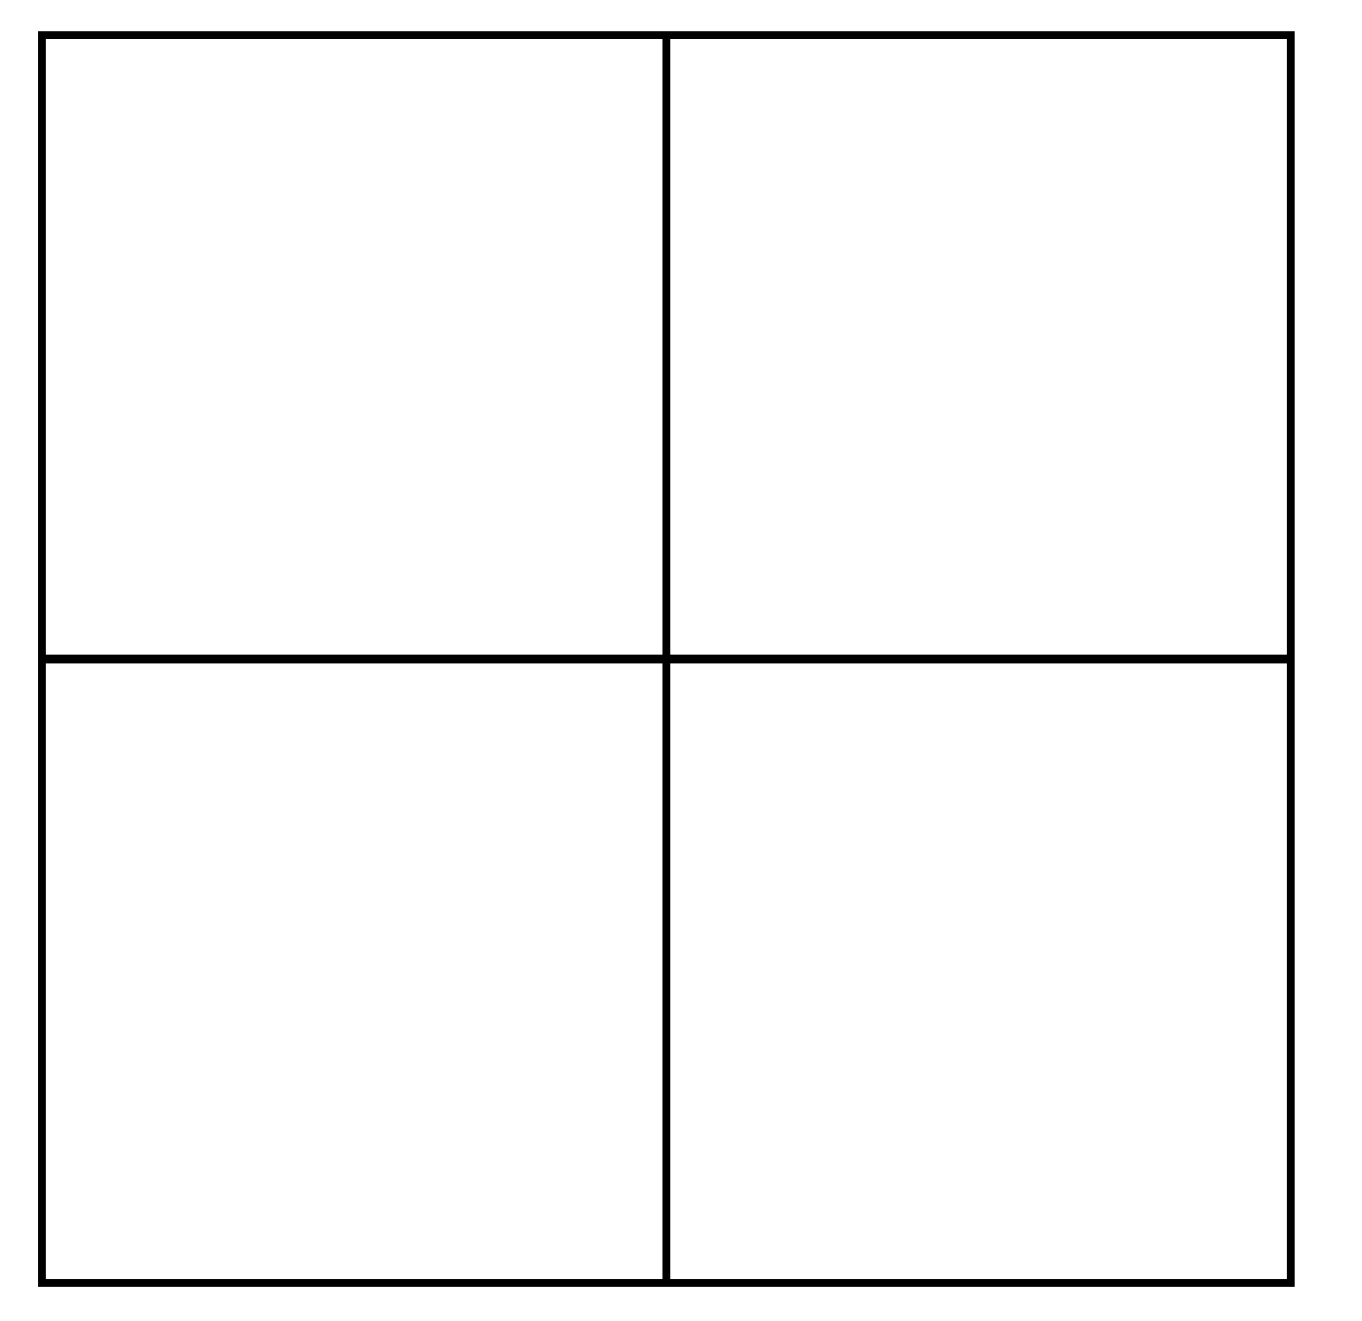
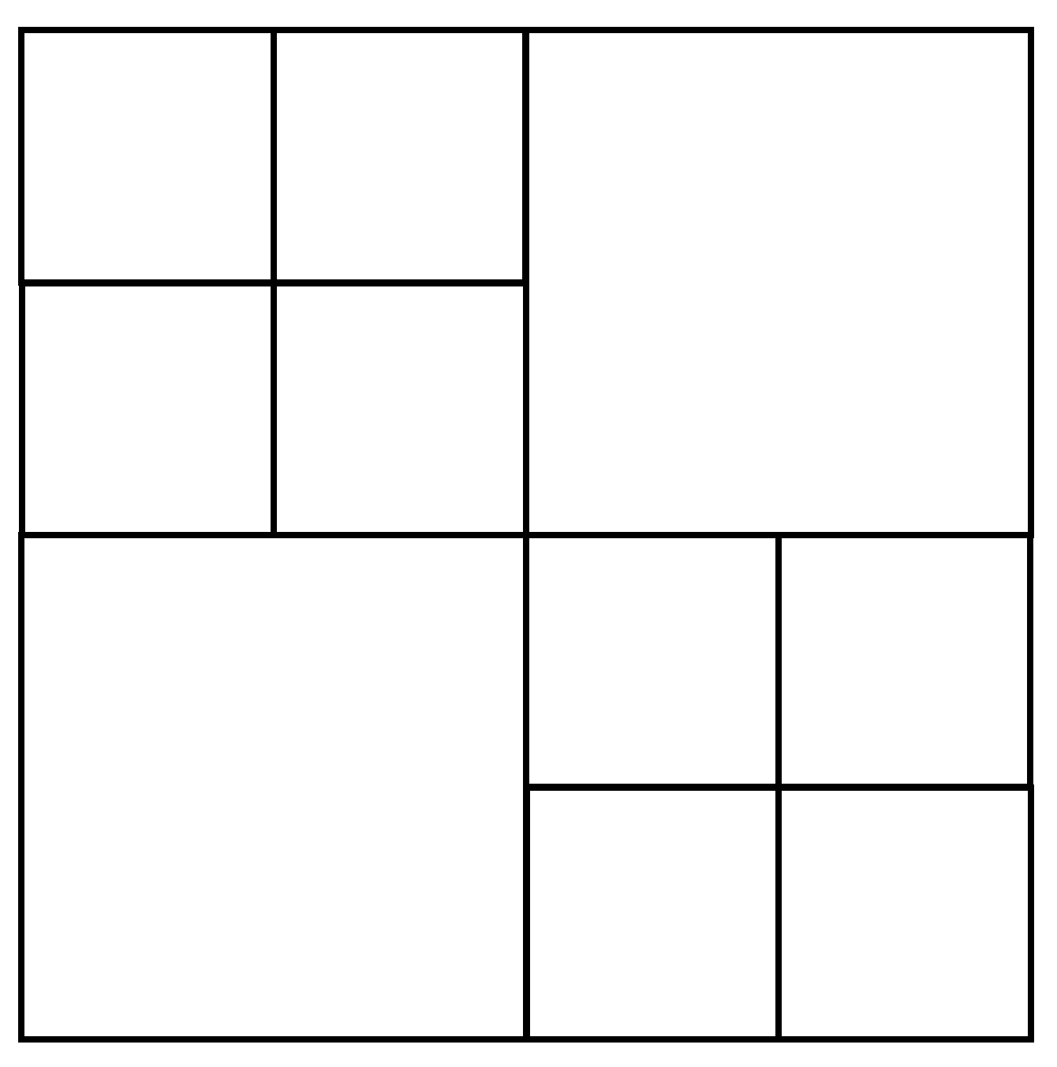
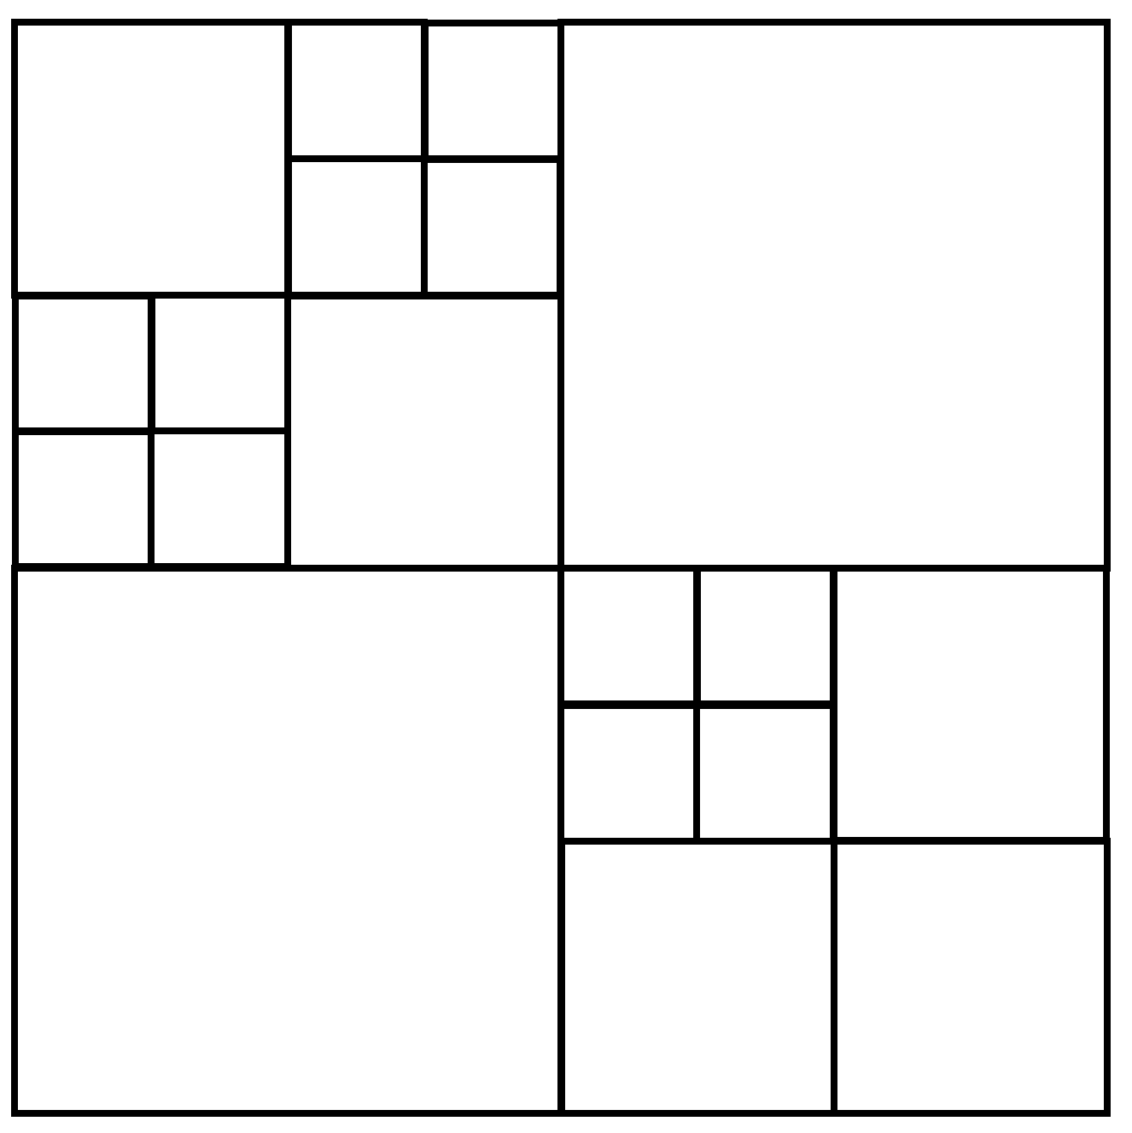
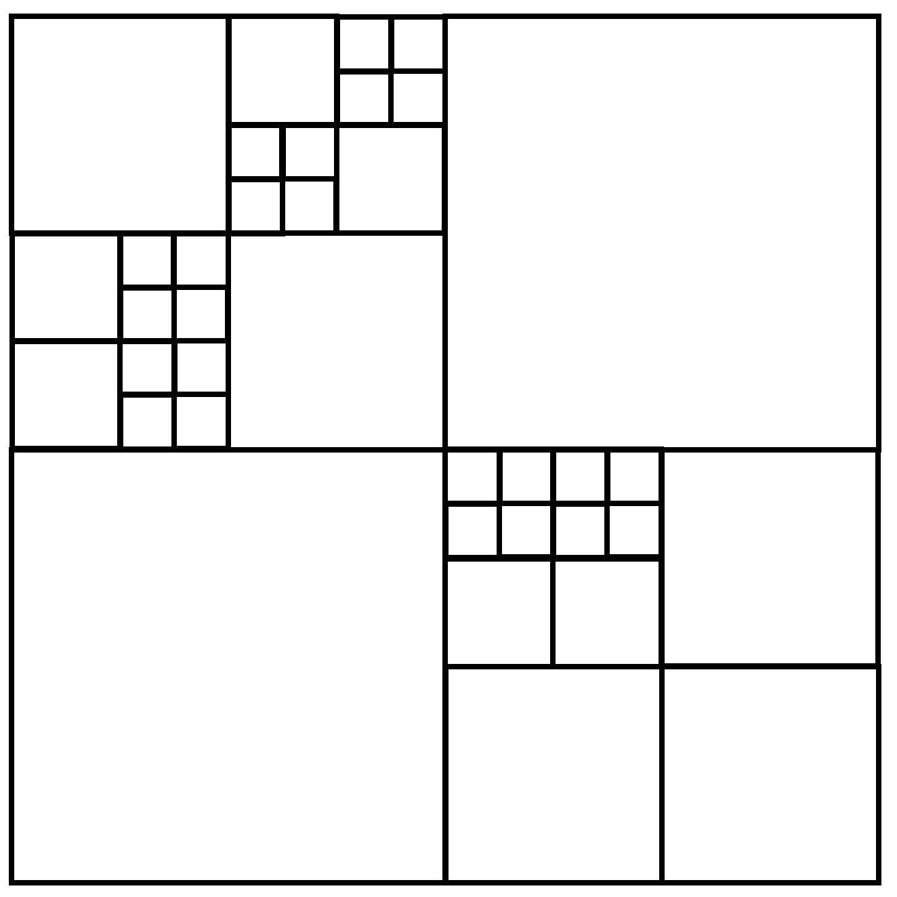
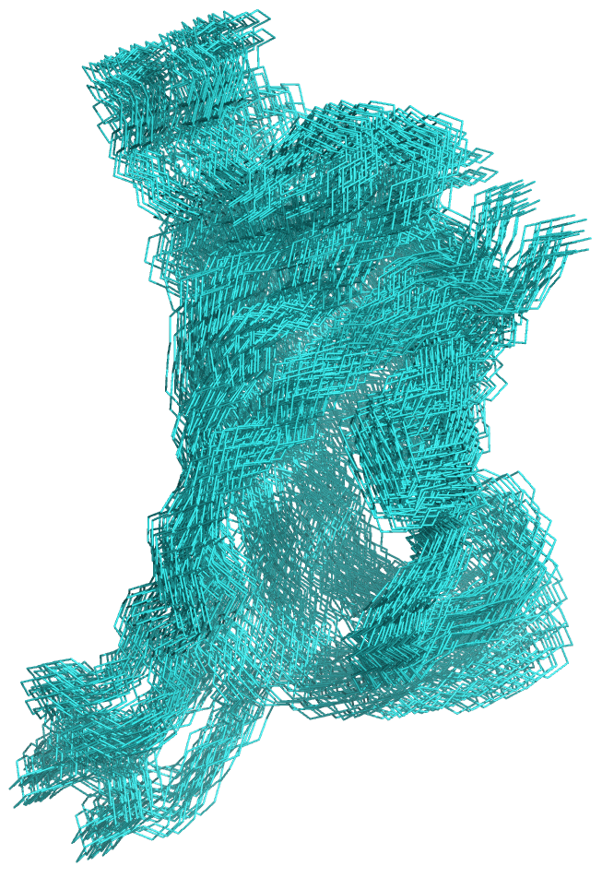
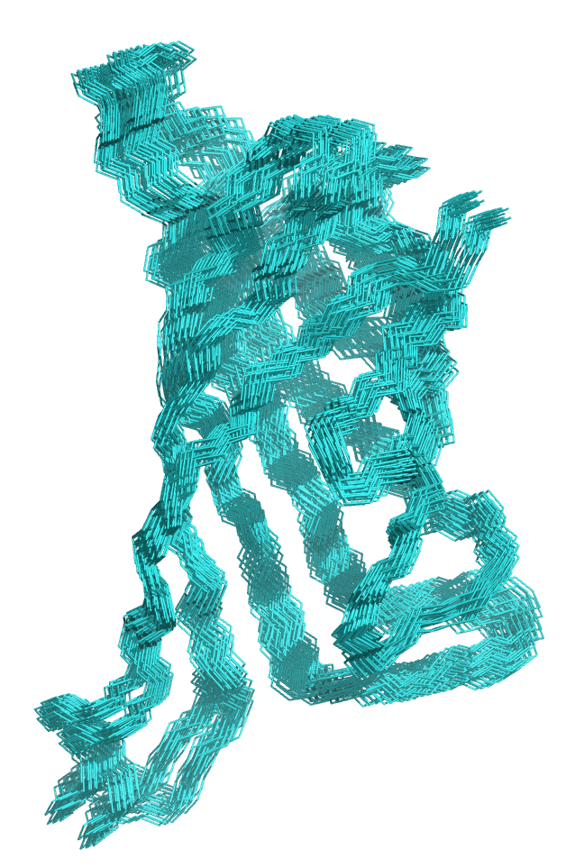
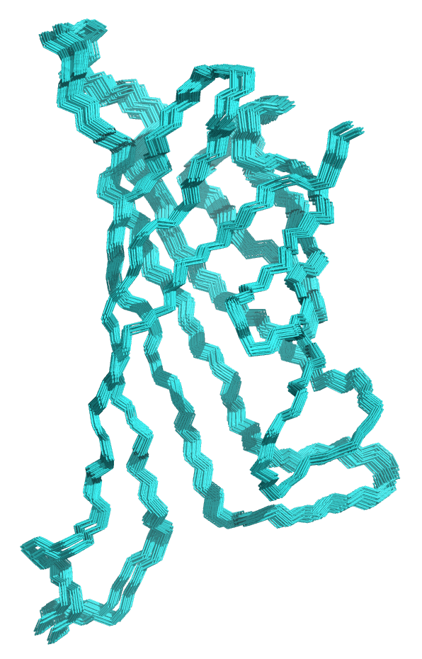
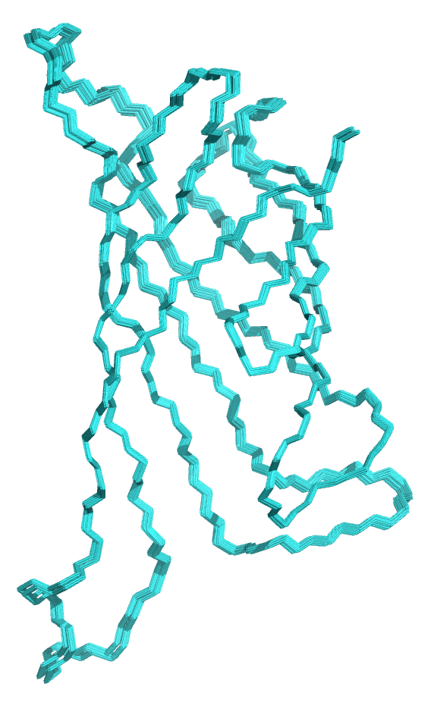
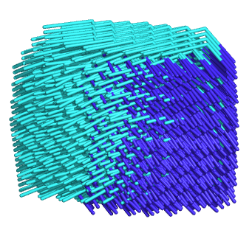
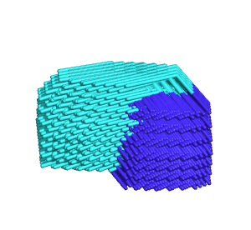
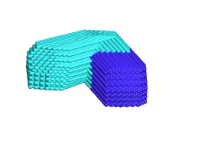
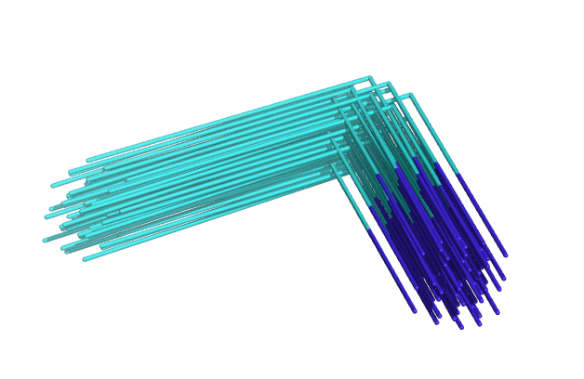
Hierarchical Search Using Bounding Functions
search
grid
ensemble
in grid
single
residue
r=8
r=4
r=2
r=1

Slide 5
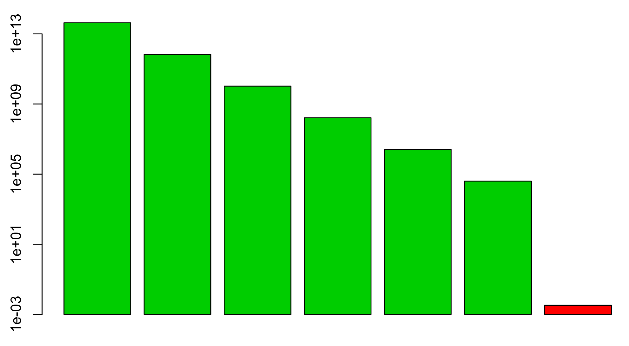
Hierarchical Search Stages
total size of 0.5Å gridded space ~1e15
(per scaffold)
“Samples” per second
RIF
16Å
~1e14
RIF
8Å
~1e12
RIF
4Å
~1e10
RIF
2Å
~1e8
RIF
1Å
~1e7
RIF
0.5Å
~1e5
Ros.
Design
~1e-2
Discrimination
Sampling

Slide 6
(very) preliminary tests

Slide 7
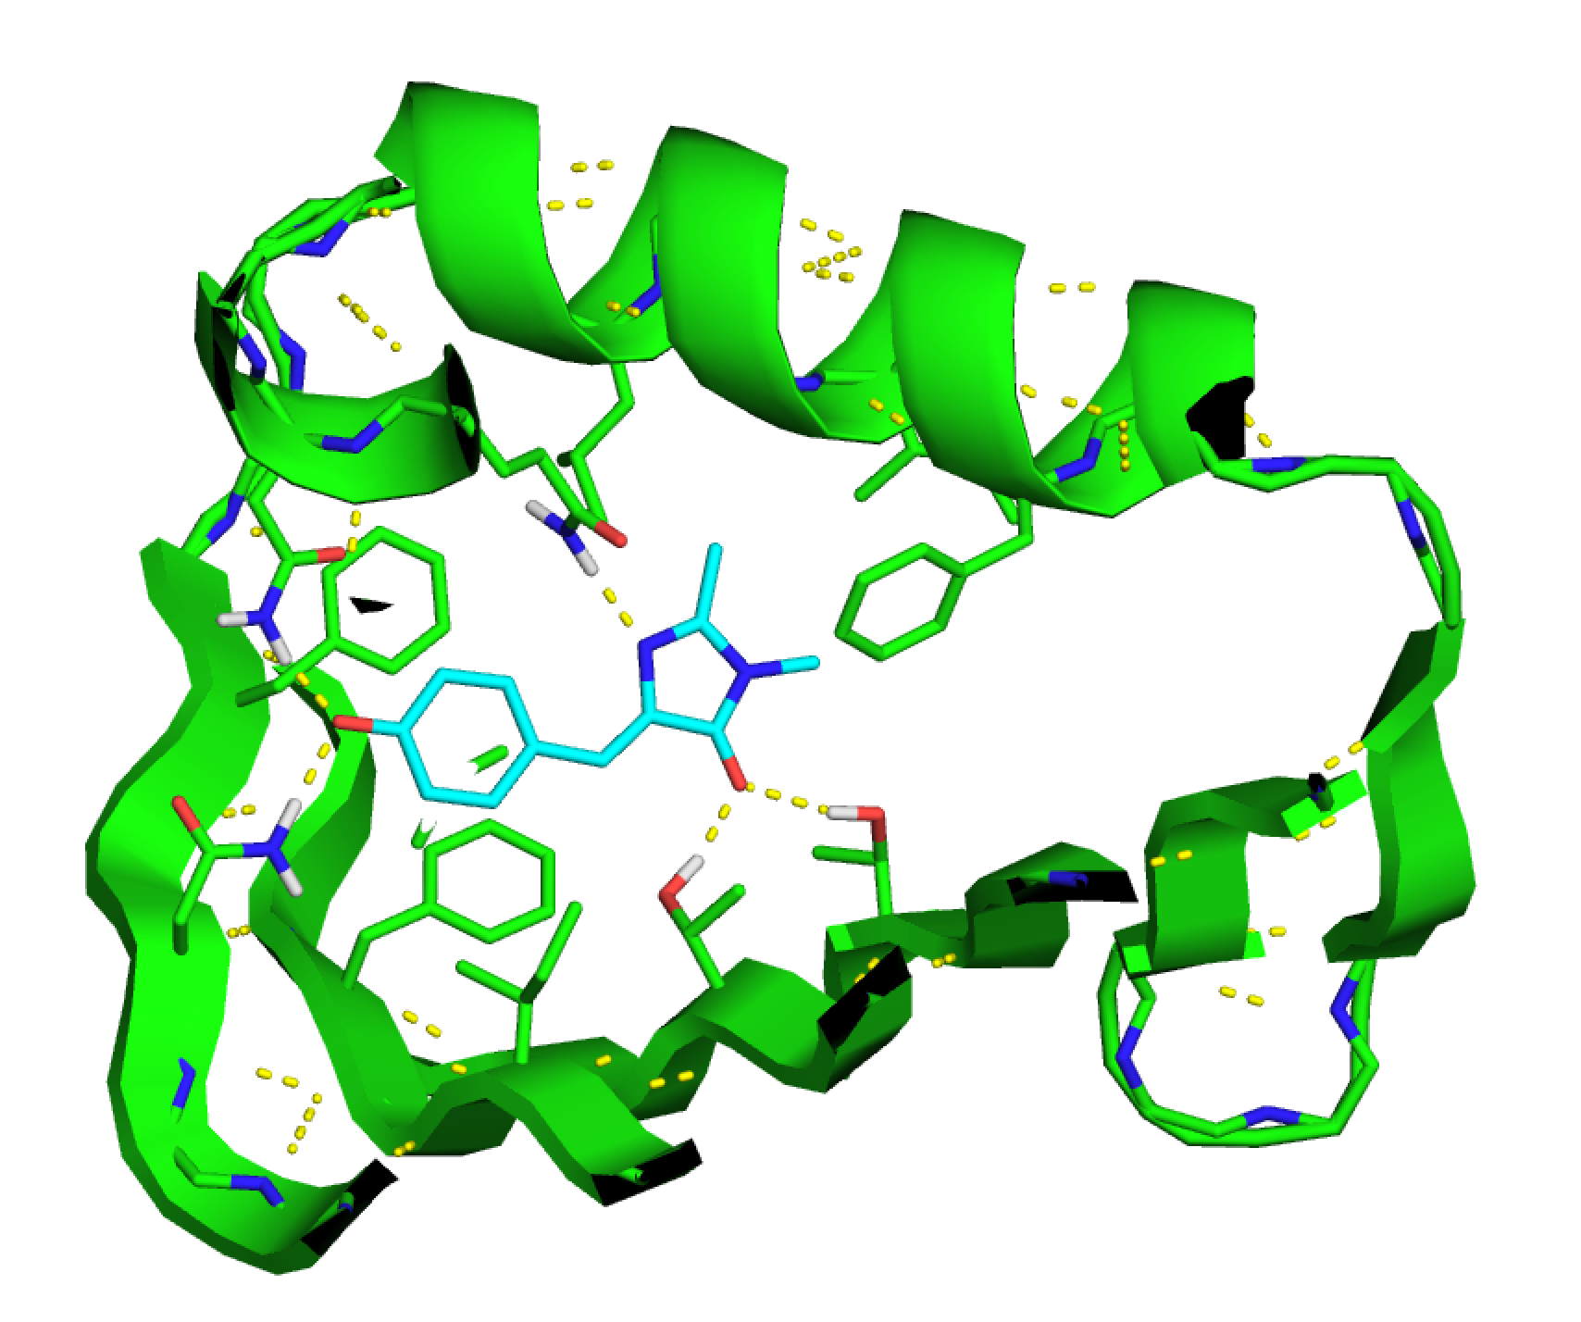
Jaiyi’s ligand: RIF Docking can find 5 good polar interactions and decent hydrophobic packing (~5400 hits in ~250 scaffolds)

Slide 8
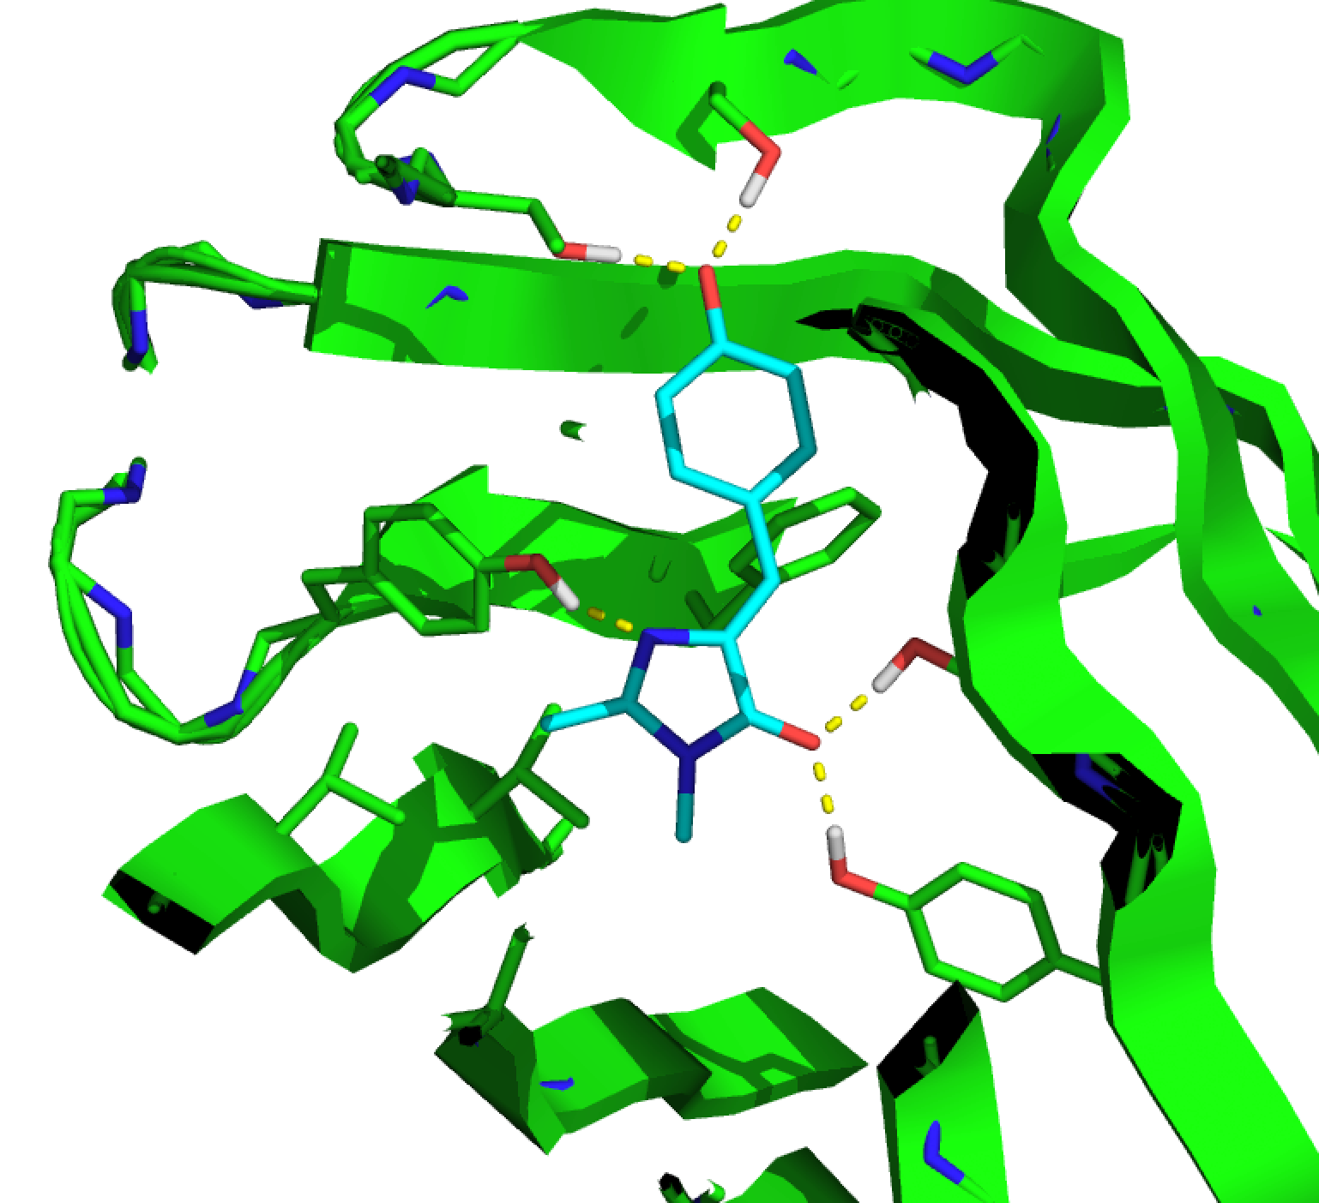
can find hits even with only SER, THR, and TYR
close to ideal rotamers & h-bonds (in this case)

Slide 9
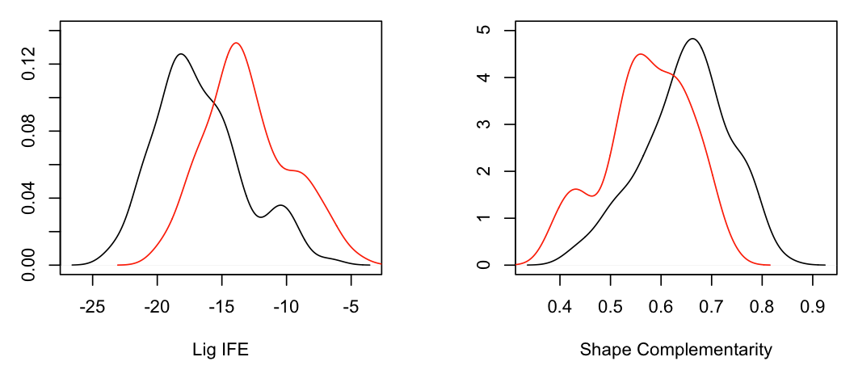
Ralph’s Biotin test
RIF
Matcher
RIF
Matcher
Ligand IFE
Shape Comp.
RIF better by ~5 REU and ~0.1 Sc on average
fair comparison (I think)
same rosetta script used in both cases

Slide 10
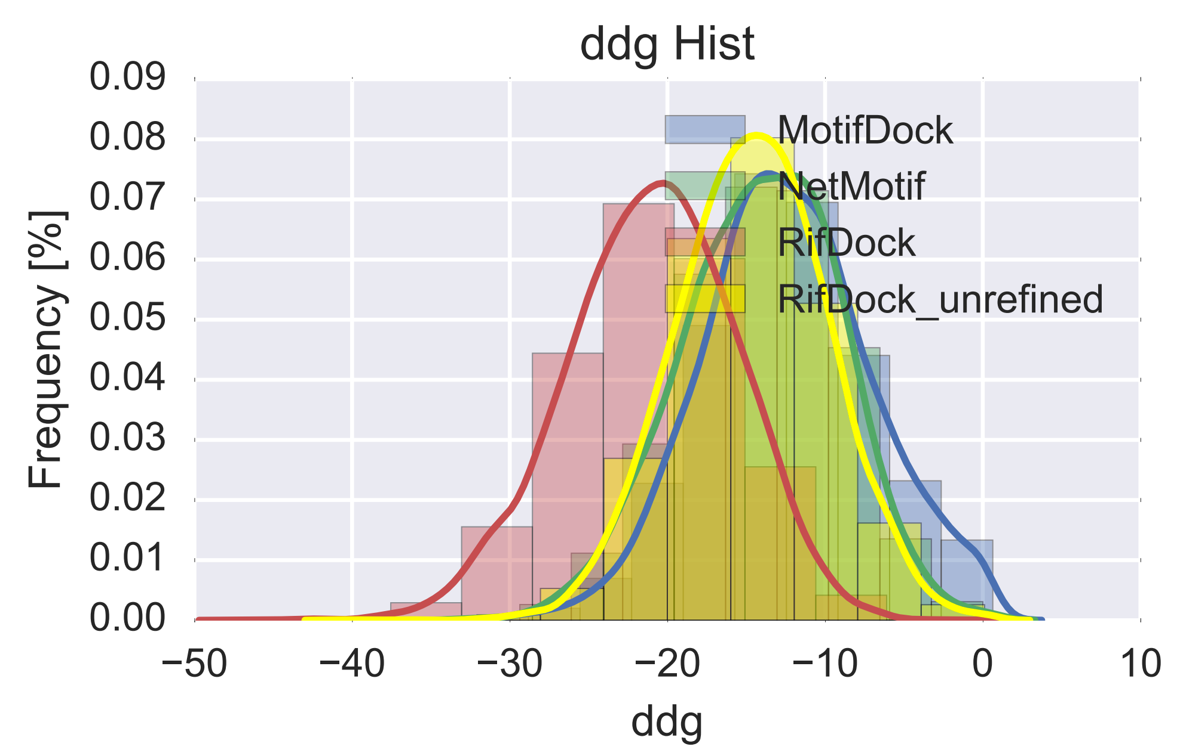
For PPI
Jorge got 26 champagne-worthy* designs on a fairly tough target with “fairly little effort”
Looks promising for PPI too
(still the “doubly-relaxed”
data, so not a fair plot)
<-
il13 DDG

Slide 11
RIF Docking initial tests, summary
initial benchmarks vs. existing methods promising
can find more interactions than matcher in less time
can recapitulate a few native interfaces
only 5 (easy) cases tested, 4 work w/o sequence, 1 with
kinda a bad test of a design method…
can show in pymol, if anybody wants to see

Slide 12
RIF Docking, new methods
° design now done with RIF rotamers at end of docking
> 10,000x speed* of “naive” rosetta packer
*not a fair comparison
° a of “constraints” now implemented
can enforce non-pairwise properties
like, every polar on my ligand must be satisfied
much much much better than filtering afterward
° (many other things that didn’t work)

Slide 13
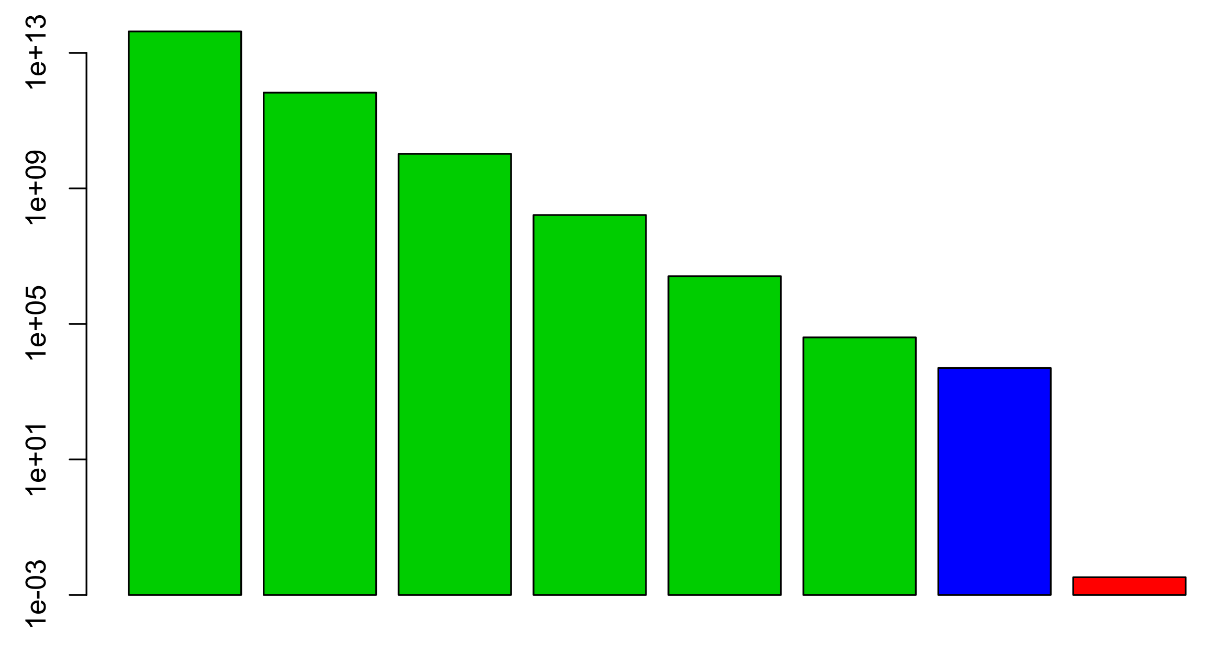
Hierarchical Search Stages, now with packing!
“Samples” per second
RIF
16Å
~1e14
RIF
8Å
~1e12
RIF
4Å
~1e10
RIF
2Å
~1e8
RIF
1Å
~1e7
RIF
0.5Å
~1e5
RIF
Pack
~1e4
Ros.
Design
~1e-2

Slide 14
design now done with RIF rotamers at end of docking
approx. 100,000x speed of “naive” rosetta packer
- no extra rots, no rots not in RIF (~100x less rots)
- most (not all) energy table entries pre-computed
- treat all fixed regions as part of one-body energy
- low-overhead implementation
- 200 lines of code
plan to extend this to pair motif system (two sided design)

Slide 15
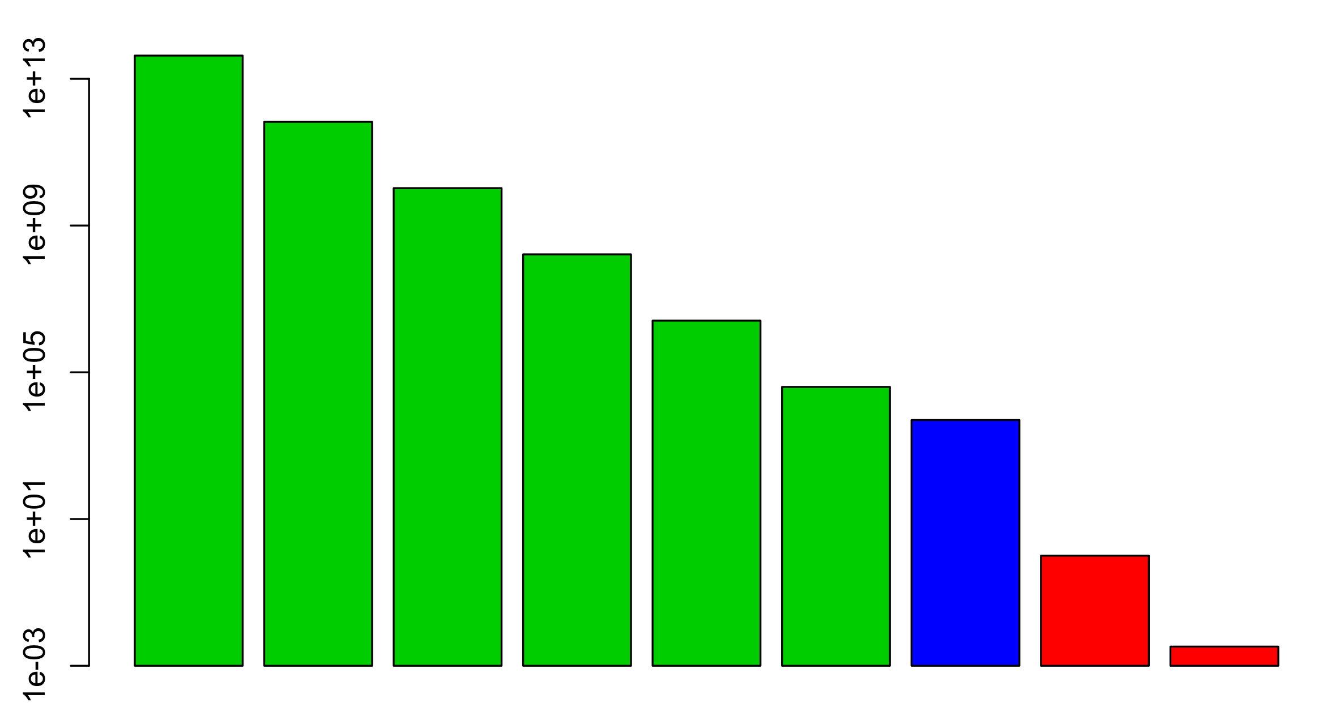
How to bridge the gap???
we need to think about this
“Samples” per second
???
???
RIF
16Å
~1e14
RIF
8Å
~1e12
RIF
4Å
~1e10
RIF
2Å
~1e8
RIF
1Å
~1e7
RIF
0.5Å
~1e5
RIF
Pack
~1e4
Ros.
ScMin
~1e1
Ros.
Design
~1e-2

Slide 16
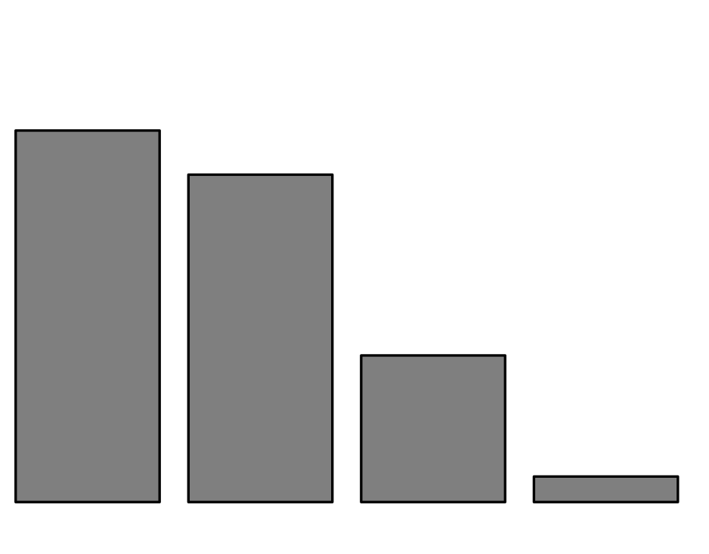
???
???
RIF
0.5Å
~1e5
RIF
Pack
~1e4
Ros.
Design
~1e-2
blue population ~= no RIF Pack (maybe between blue and yellow)
yellow population ~= RIF Pack then ignore placed rotamers
red population ~= RIF Pack, FastDesign force placed forced rotamers
very hand-wavy, I know…

Slide 17
Add rosetta sc/rb min
minimize RIF rotamers + ligand
with fixed BB
“Samples” per second
RIF
16Å
~1e14
RIF
8Å
~1e12
RIF
4Å
~1e10
RIF
2Å
~1e8
RIF
1Å
~1e7
RIF
0.5Å
~1e5
RIF
Pack
~1e4
Ros.
ScMin
~1e1
Ros.
Design
~1e-2

Slide 18
° some forms of “constraints” now implemented
can enforce non-pairwise properties
like, every polar on my ligand must be satisfied
much much much better than filtering afterward
° possible applications:
force polar satisfaction
force user-defined hotspots
force surface coverage

Slide 19
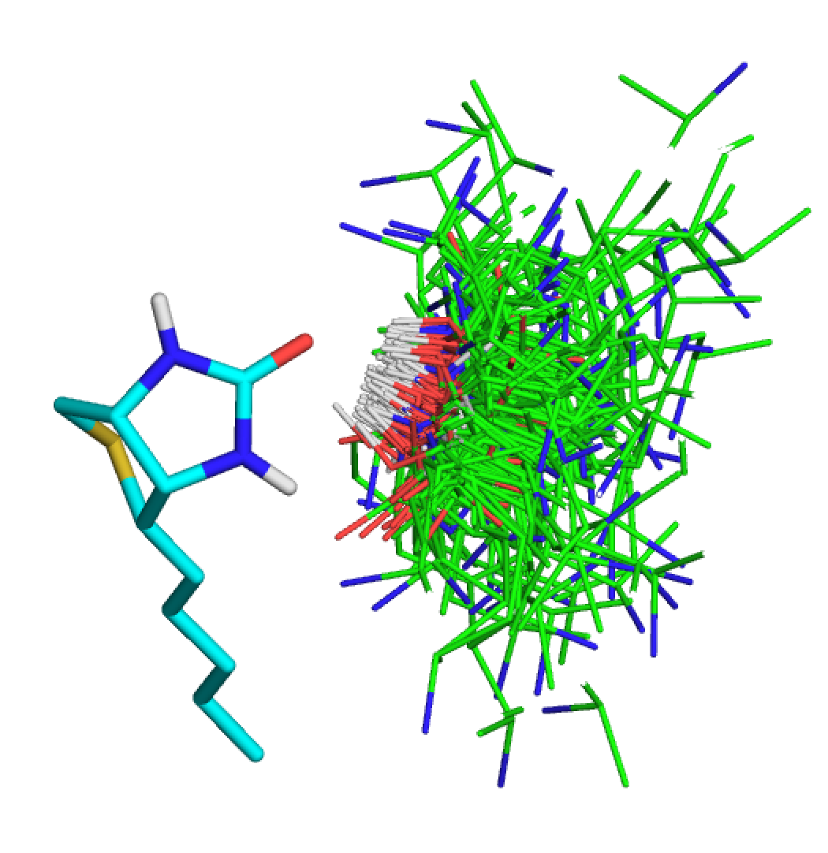
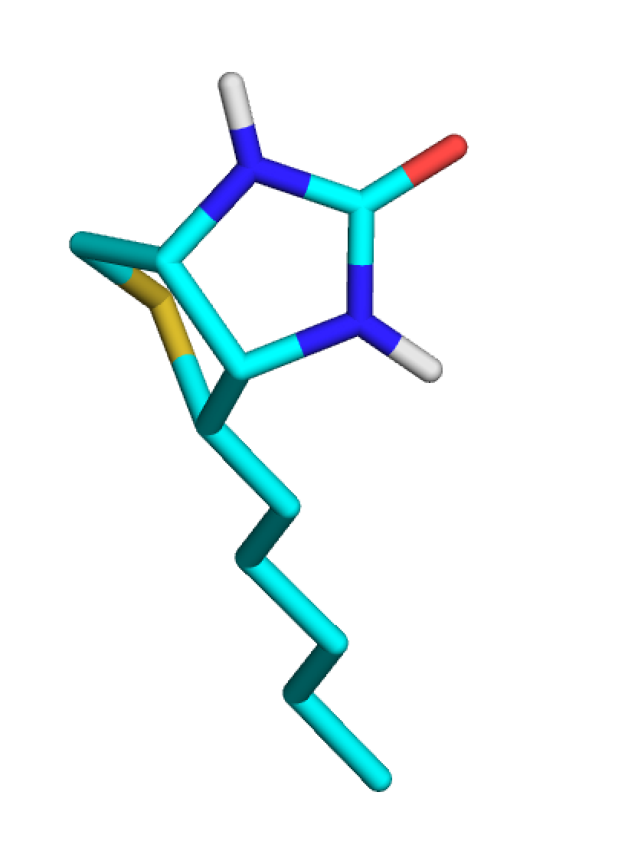
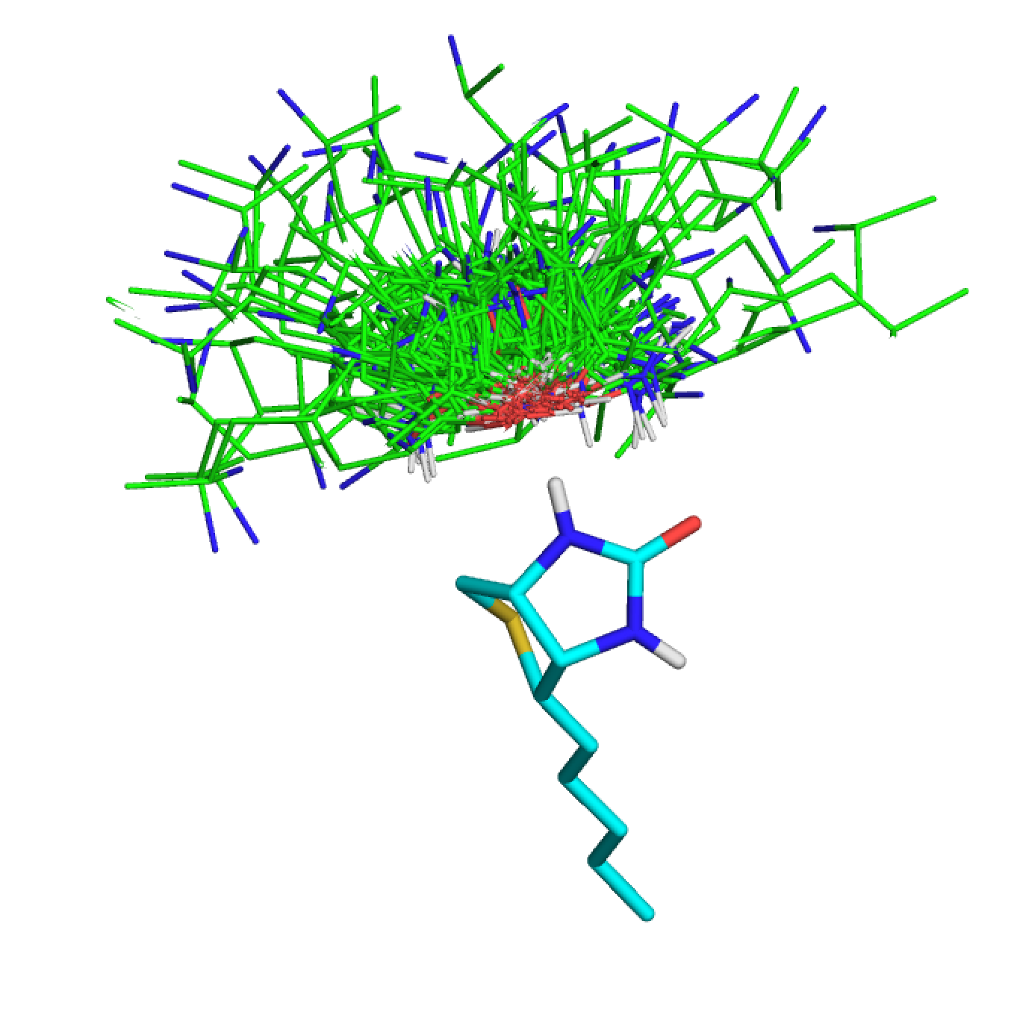
1
3
2
3
1
4

Slide 20
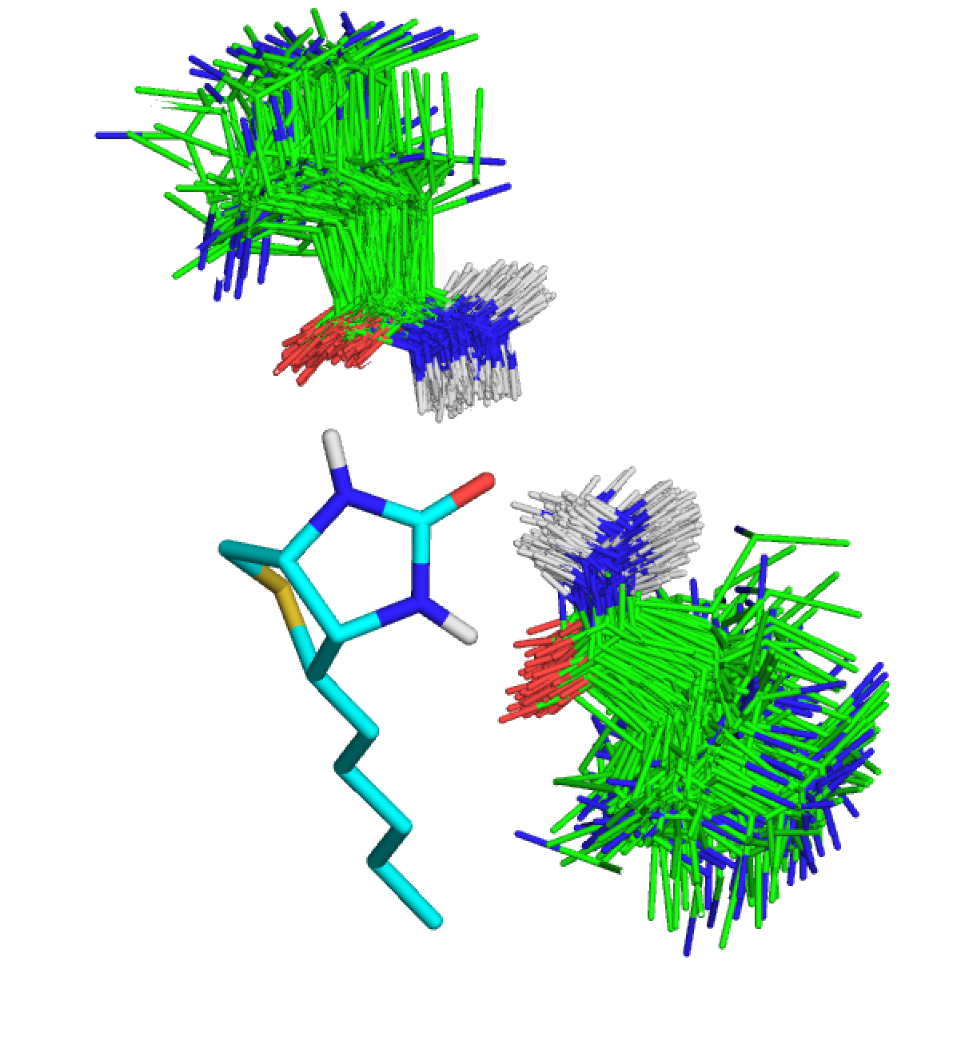
Some rotamers might satisfy more than on CST…
1
2
1
2
3
4
4
3

Slide 21
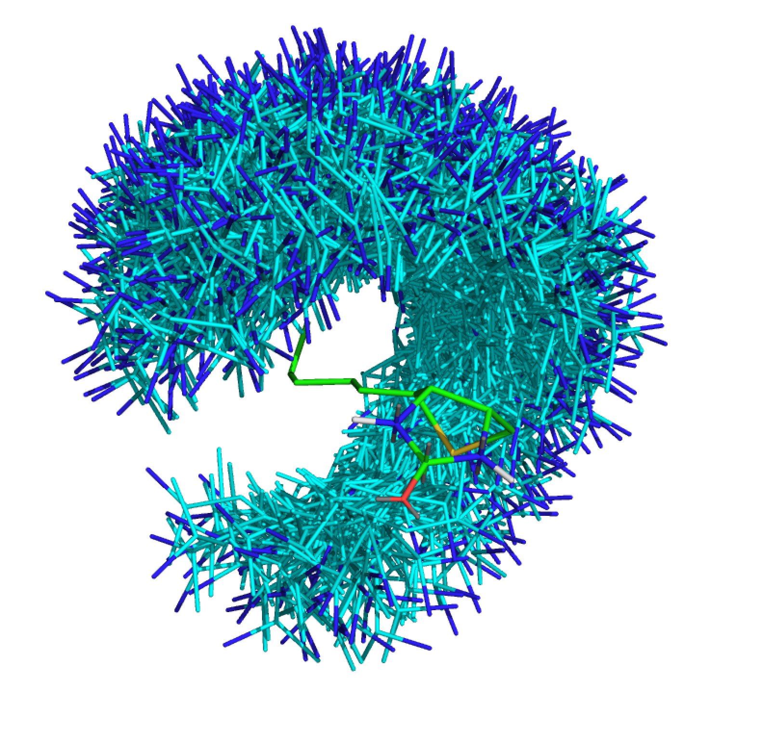
Or None…
1
2
-
3
4

Slide 22
Constraints 1, 2, 3 & 4 must be satisfied…
BB xyz frame
BB xyz frame
RIF Data for BB-Position
ROT# | Score | sat1 | sat2
23 | -2.14 | 4 | -
32 | -1.718 | 4 | -
7 | -1.3 | 2 | -
100 | -1.0 | - | -
YES!
BB xyz frame
BB xyz frame
BB xyz frame
RIF Data for BB-Position
ROT# | Score | sat1 | sat2
7 | -3.14 | 2 | -
392 | -2.718 | 2 | -
81 | -1.3 | 1 | 3
13 | -1.0 | - | -
…
Target
(ligand, protein surface, metal site, theozyme…)
RIF Data for BB-Position
ROT# | Score | sat1 | sat2
7 | -3.14 | 1 | -
392 | -2.718 | 1 | -
81 | -1.3 | 1 | 3
13 | -1.0 | - | -
…

Slide 23
Constraints 1, 2, 3 & 4 must be satisfied…
BB xyz frame
RIF Data for BB-Position
ROT# | Score | sat1 | sat2
7 | -3.14 | 1 | -
392 | -2.718 | 1 | -
81 | -1.3 | 1 | 3
13 | -1.0 | - | -
BB xyz frame
NO!
BB xyz frame
BB xyz frame
BB xyz frame
RIF Data for BB-Position
ROT# | Score | sat1 | sat2
23 | -2.14 | 4 | -
32 | -1.718 | 4 | -
7 | -1.3 | 1 | -
100 | -1.0 | - | -
Target
(ligand, protein surface, metal site, theozyme…)
…
…

Slide 24
each RIF rotamer can be part of a group (or two or three)
search can enforce (at least) one member of each group is there
These are stupid constraints, who cares?
yes, the have a very restricted form…
but they make searches more efficient

Slide 25
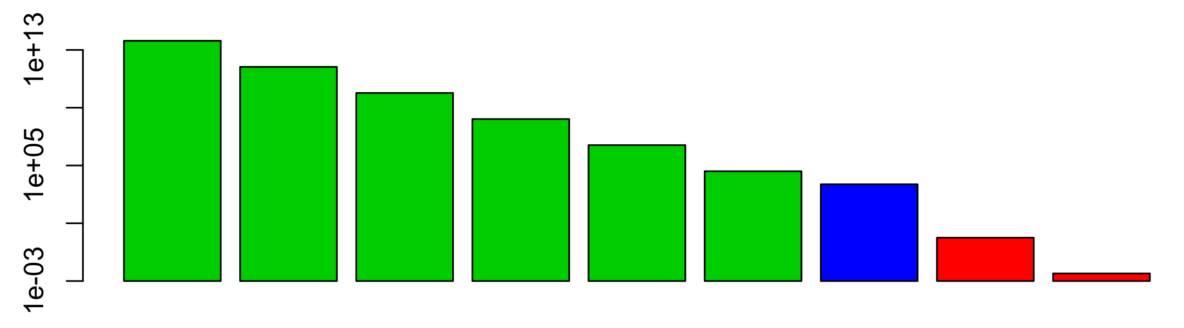
Complex constraints, applied
at the end (and/or Filters)
???
???
knowledge is applied to only a few designs
Simple constraints, applied
all the way through
???
???
knowledge is applied to everything

Slide 26
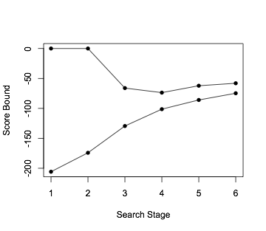
without constraints
Score range by search stage
16Å 8Å 4Å 2Å 1Å 0.5Å

Slide 27
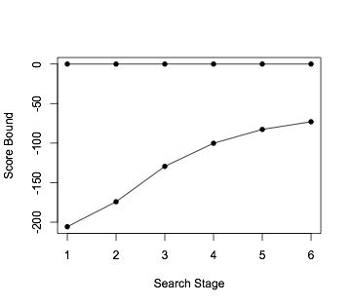
with h-bond satisfaction constraints
Score range by search stage
16Å 8Å 4Å 2Å 1Å 0.5Å

Slide 28
Possible applications for these group “constraints”
force polar satisfaction
force user-defined hotspots
force surface coverage
???

Slide 29
plans…
implement new constraints (hotspot, surface contact)
do something WRT 2nd shell satisfaction
reject things that can’t be backed up
something hbnet-like? tricky…
handle some target flexibility
proton chis
rotamer-level flexibility (reworked pair-motifs)
flexible backbone (???)
hierarchical search in scaffold space as well
if we ever want to dock millions of scaffolds

Slide 30
I forget
lots of people
THANKS!
Ideas &
Discussion
Alex
Jorge
Daniel
Scott
DB
Beta Testers
Ralph
Jaiyi
Gerard
Benjamin
Jorge
Franziska
Danny

Slide 31
A little more detail…
(optional)

Slide 32
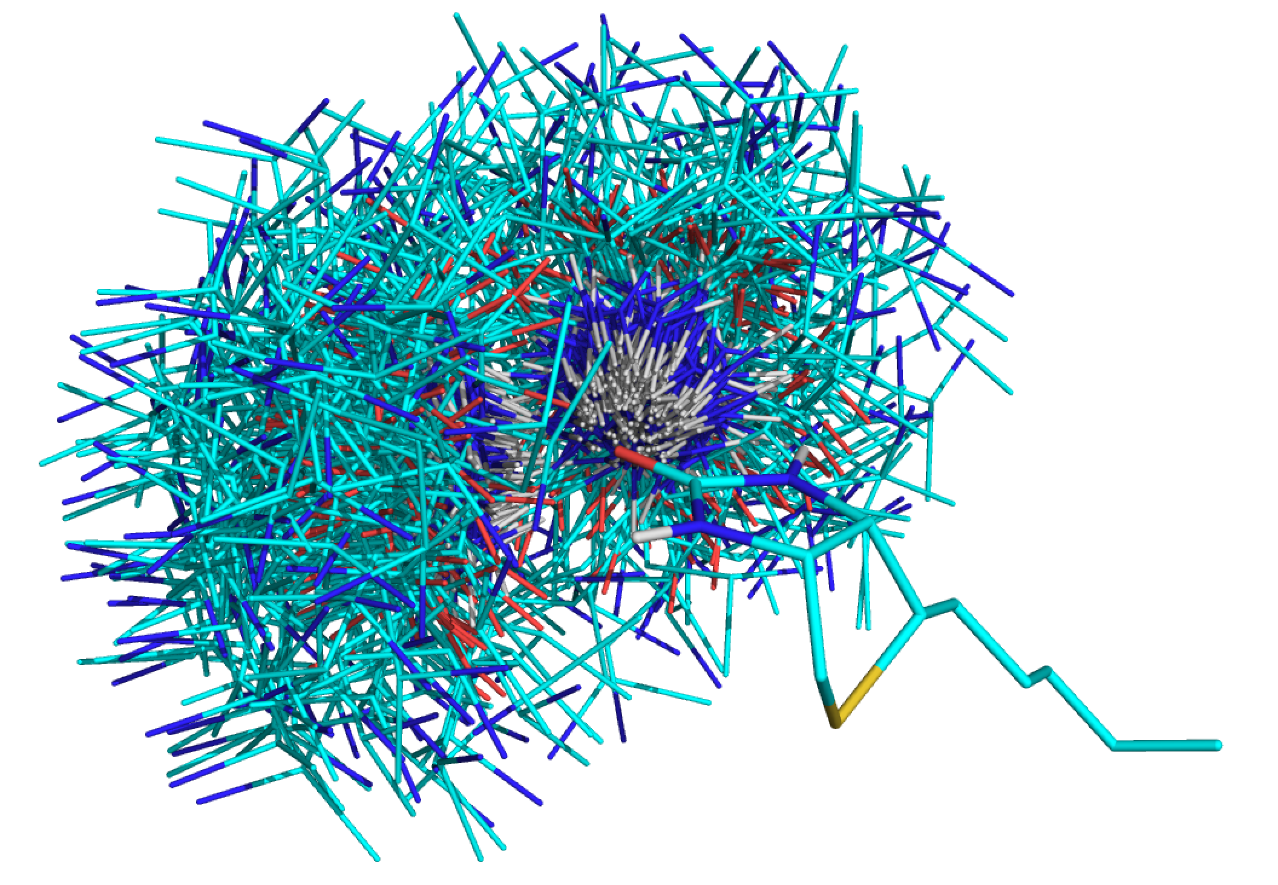
What is a RIF?
contain ~10 billion inverse rotamers
store (approx.): score v. tgt + bb position + rotamer id
logically, like a giant set of hotspots (but less picky)
donors to BTN
leu(80) 1.4

Slide 33
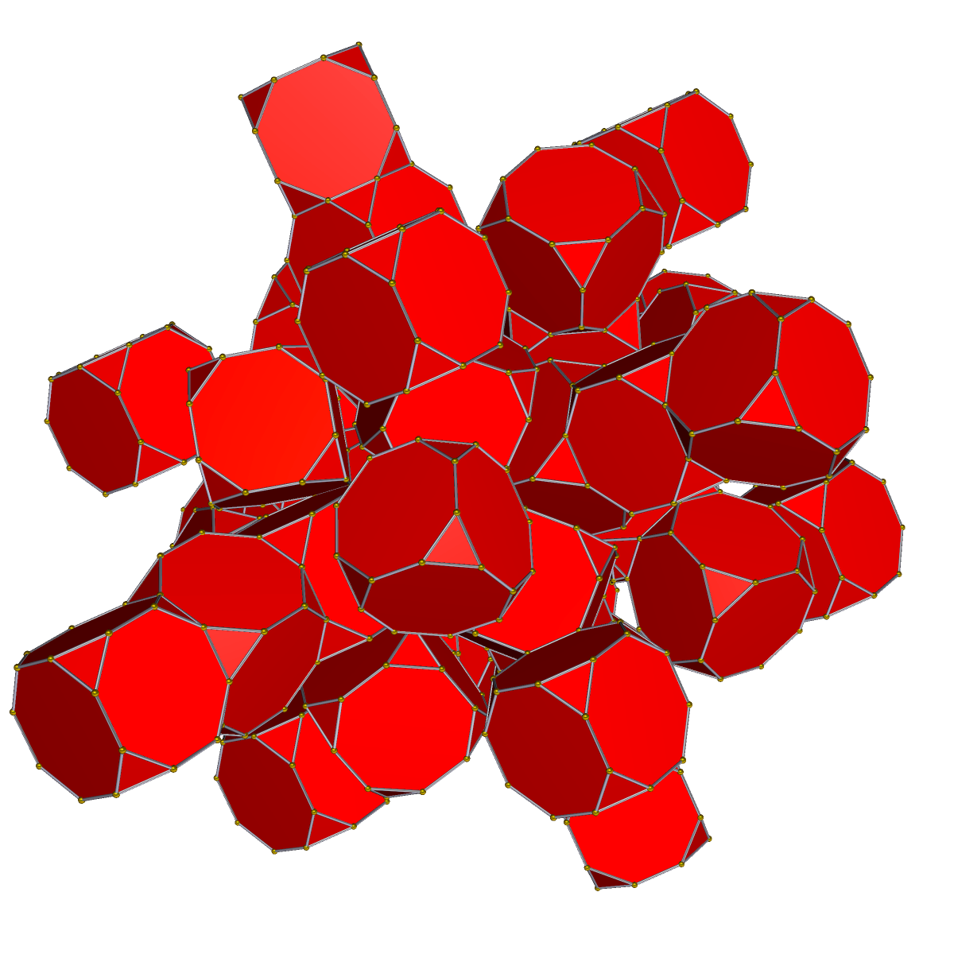
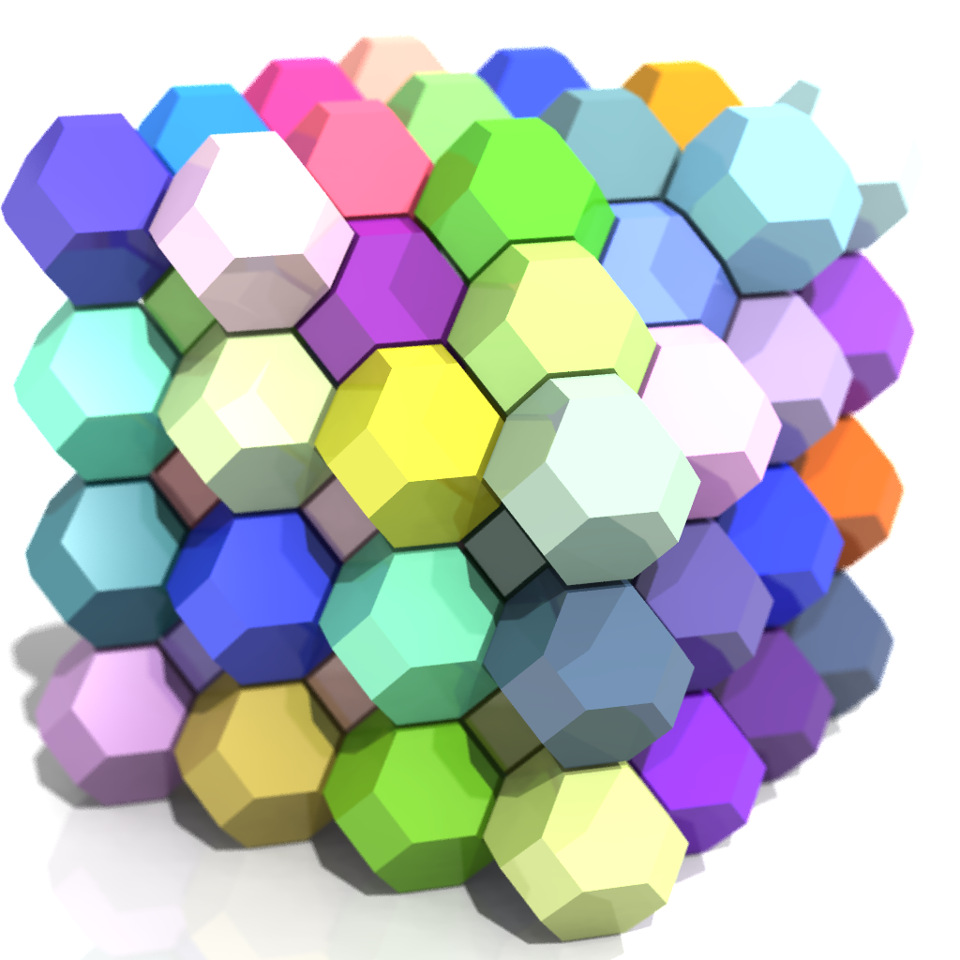
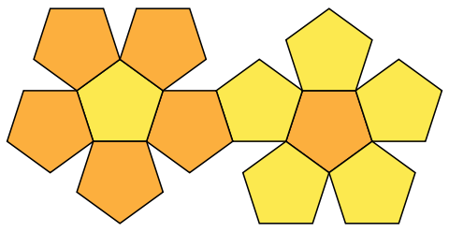
how RIF is stored (sparse, resolution ~0.6 A)
6D BCC
Lattice
6D BCC
Lattice
RIF
ROT# | Score
7 | -3.14
392 | -2.718
81 | -1.3
13 | -1.0
flattened
dodecahedron
“flattened”bitruncated 24-cell
(tetracontoctachoron)
imgs: wikipedia

Slide 34
Docking Into RIF
BB xyz frame
BB xyz frame
BB xyz frame
BB xyz frame
kinda like docking into a 6D density
but in addition, also store rotamers in RIF:
BB xyz frame
4
Target
(ligand, protein surface, metal site, theozyme…)
RIF
ROT# | Score
7 | -3.14
392 | -2.718
81 | -1.3
13 | -1.0
2
problem: ~100 trillion configurations to search at resolution necessary for rotamer placement

Slide 35
Hierarchical Search Using Bounding Functions
search
grid
ensemble
in grid
single
residue
r=8
r=4
r=2
r=1

Slide 36
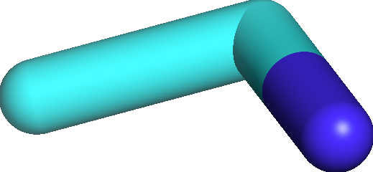
Bounding Functions
“Raw” Grid
“Bounding” Grid

Slide 37



Objective Function Used in Docking (very fast)
E( scaffold, target )
+
E( rotamers, target )
+
E( rotamers, scaffold )
+
E( rotamers , rotamers )
+
E( scaffold, scaffold )
+
E( target, target )
R
S
Etot =
T

Slide 38

Objective Function Used in Docking (very fast)
E( scaffold, target )
+
E( rotamers, target )
+
E( rotamers, scaffold )
+
E( rotamers , rotamers )
+
E( scaffold, scaffold )
+
E( target, target )
R
S
Etot =
T
Fixed

Slide 39
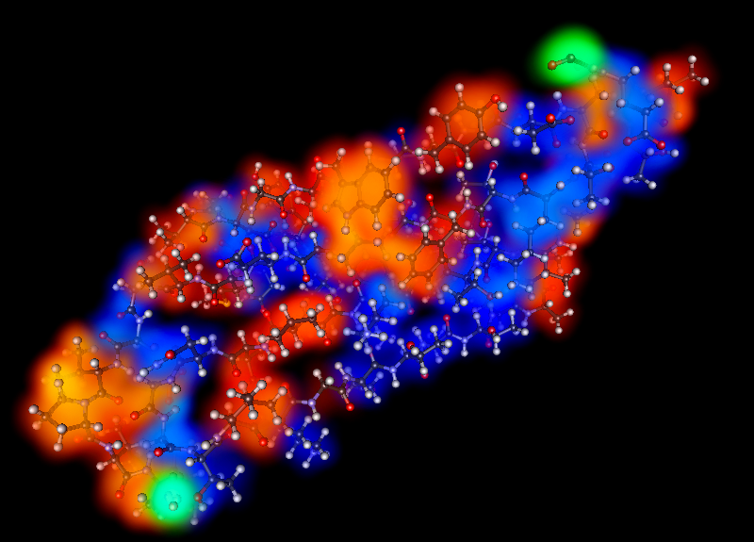


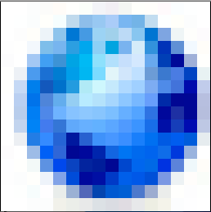
Objective Function Used in Docking (very fast)
E( scaffold, target )
+
E( rotamers, target )
+
E( rotamers, scaffold )
+
E( rotamers , rotamers )
+
E( scaffold, scaffold )
+
E( target, target )
good approx. using 3D grids
atoms of smaller vs grid of larger
Example:
Etot =
VDW+
SOL+ELEC

Slide 40
Objective Function Used in Docking (very fast)
E( scaffold, target )
+
E( rotamers, target )
+
E( rotamers, scaffold )
+
E( rotamers , rotamers )
good approx. using 3D grids
atoms of smaller vs grid of larger
looked up in precomputed
“Rotamer Interaction Field” (RIF)
Etot =
BB xyz frame
BB xyz frame
BB xyz frame
BB xyz frame
BB xyz frame
2
Target
3

Slide 41

Objective Function Used in Docking (very fast)
E( scaffold, target )
+
E( rotamers, target )
+
E( rotamers, scaffold )
+
E( rotamers , rotamers )
good approx. using 3D grids
atoms of smaller vs grid of larger
looked up in precomputed
“Rotamer Interaction Field” (RIF)
Etot =
lookup rotamers in RIF, then
lookup each rot in precomputed
1-body energy table for scaffold
Scaffold 1B
ROT# | Score
… | …
7 | 11.3
392 | 0.3
81 | -1.5
13 | 2.7
… | …
RIF
ROT# | Score
7 | -3.14
392 | -2.718
81 | -1.3
13 | -1.0
TOT
ROT# | Score
7 | 14.44
392 | -2.418
81 | -2.8
13 | 2.7
+
=

Slide 42
Objective Function Used in Docking (very fast)
E( scaffold, target )
+
E( rotamers, target )
+
E( rotamers, scaffold )
+
E( rotamers , rotamers )
+
E( scaffold, scaffold )
+
E( target, target )
good approx. using 3D grids
atoms of smaller vs grid of larger
looked up in precomputed
“Rotamer Interaction Field” (RIF)
Etot =
lookup rotamers in RIF, then
lookup each rot in precomputed
1-body energy table for scaffold
look up in RIF,
looked up in 2-body table,
small packing calculation

Slide 43
E( scaffoldBB, target )
+
E( rotamers, target )
+
E( rotamers, scaffold )
+
E( rotamers , rotamers )
good approx. using 3D grids
LOW-RES: looked up in precomputed
“Rotamer Interaction Field” (RIF)
HIGH-RES: recompute more-accurate
rotamer-target energy
lookup rotamers in RIF, then
lookup each rot in precomputed
1-body energy table for scaffold
LOW-RES: ignored
HIGH-RES: look up candidate rotamers
in RIF, small packing calculation

Slide 44
COMPUTABILITY
Undefined (doesn’t even make sense) | Exponential (utterly terrible) | NotPolynomial (bad, but manageable) | Polynomial (good, mostly) | Whiteboard Math (perfect, but usually fantasy)
Molucular Dynamics (Physical Simulation) | Rosetta (Monte Carlo) | Branch & Bound (my stuff) | Lattice Models(?) Linear Program … | E = MC²
Differentiable Energy Function | Pair-decomposable Energy Function + Kinematic model | Energy Func. with bounding heuristics + hierarchical sampling structure | protein is a cuboid snake of two colors? | Let the protein be a Sphere of radius r…
MODELING POWER (maybe)

Slide 45
Hierarchical Search Using Bounding Functions
search
grid
ensemble
in grid
single
residue
r=8
r=4
r=2
r=1

